Slide 1

Weather Image Classification Using CNNs
Aliyan Ahmed Cheema FA22-BCE-028

Slide 2

Introduction and Problem Description
Deep learning-based weather classification using images.
Manual monitoring is inefficient; sensors are expensive.
Goal: CNN model to classify 4 weather types.
Use in smart cities and automated systems.

Slide 3
Dataset Description
Dataset: Weather Image Dataset
Classes: Cloudy, Lightning, Rainy, Sunrise
Resized to 128×128, normalized
Preprocessing: ImageDataGenerator, 80/20 split

Slide 4
Algorithm Description
CNN in TensorFlow/Keras
3 Conv layers + MaxPooling
Dense layers with ReLU and Softmax
Loss: Categorical Crossentropy, Optimizer: Adam
Metrics: Accuracy, Confusion Matrix

Slide 5
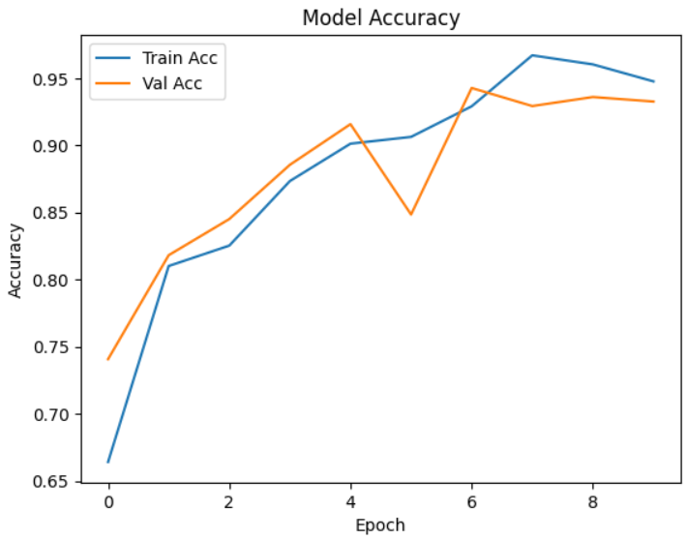
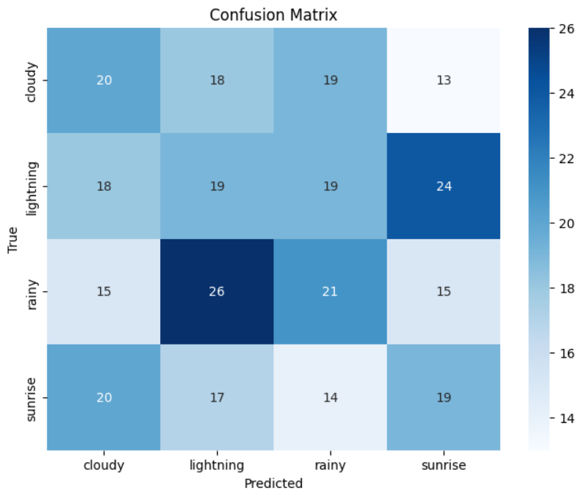
Results
10-epoch training
Accuracy improved gradually
Final validation accuracy ~97%
Confusion matrix showed strong performance

Slide 6
Analysis
Model generalized well
Data augmentation can help
Minor class imbalance (e.g., lightning)
Real-time potential

Slide 7
Summary and Conclusion
Built and tested a CNN for weather image classification
Effective with limited data
Practical and scalable solution
Future scope: mobile or IoT integration

